Slide 1

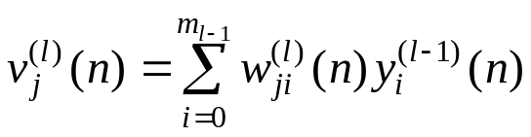




Multilayer Perceptron
Initialization
Forward Computation
  Output from neuron j in layer l
  where
  where is the output signal of neuron i in the previous layer l−1
  and is the synaptic weight of neuron j in layer l that is fed from neuron i in layer l−1
  if l = 1, and if l = L,
  compute the error: e_{j}(n) = d_{j}(n) − o_{j}(n)

Slide 2
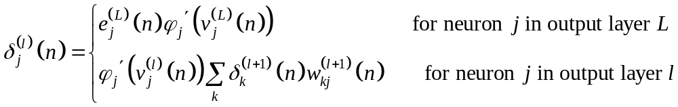

Backward computation
  Local gradients
  where denotes differentiation with respect to the argument
  Update weights
Iteration: until the stopping criterion is met

Slide 3
Heuristic for making the Back-propagation algorithm perform better
  Sequential versus batch update
  Maximizing information content
  Activation function
  Target value
  Normalizing the inputs
  Initialization
  Learning from hints
  Learning rate
Generalization

